Slide 1

FINANCIAL ANALYSIS PROJECT
Name: Sachin Eknathrao Gunjal
Batch: CX-132-MOR-MAY
Topic: Excel Project 2

Slide 2
This project aims to provide a foundational understanding of key financial functions and terminologies used in Microsoft Excel. A strong grasp of these concepts is essential for effectively utilizing functions such as PV, NPV, XNPV, IRR, MIRR, and XIRR. By analyzing a structured dataset, the project demonstrates the practical application of these financial functions to extract meaningful and actionable financial insights.
INTRODUCTION

Slide 3
Project Scope and Objectives
Scope
Utilize Excel to perform financial analysis.
Apply various financial functions to solve real-world financial problems.
Create a summary report based on the analysis conducted.
Objectives
Understand and use Excel functions for financial analysis.
Calculate present value, net present value, and internal rate of return for different scenarios.
Determine the effective interest rate, loan term, and EMI for given financial data.
Generate a detailed summary report of insights and analysis.

Slide 4
Key Financial Concepts and Functions
Present Value (PV)
The present value is the total amount that a series of future payments is worth now. Excel Function:
PV =PV(rate, nper, pmt, [fv], [type])
rate: Interest rate per period.
nper: Total number of payment periods.
pmt: Payment made each period.
fv: Future value (optional).
type: Payment type (0 for end of period, 1 for beginning of period).

Slide 5
Net Present Value (NPV)
NPV calculates the net present value of an investment based on a discount rate and a series of future payments and incomes.
NPV =NPV(rate, value1, [value2], ...)
rate: Discount rate.
value1, value2, ...: Cash flows.
XNPV
XNPV calculates the net present value for a schedule of cash flows that are not necessarily periodic.
XNPV =XNPV(rate, values, dates)
rate: Discount rate.
values: Cash flows.
dates: Corresponding dates of the cash flows.

Slide 6
Equated Monthly Installment (EMI)
An EMI is a fixed payment amount made by a borrower to a lender at a specified date each calendar month.
PMT =PMT(rate, nper, pv, [fv], [type])
rate: Interest rate per period.
nper: Total number of payment periods.
pv: Present value or loan amount.
fv: Future value (optional).
type: Payment type (0 for end of period, 1 for beginning of period).
Interest and Principal Components of EMI
To calculate the interest and principal parts of the EMI:
Interest Component: IPMT =IPMT(rate, per, nper, pv, [fv], [type])
Principal Component: PPMT =PPMT(rate, per, nper, pv, [fv], [type])
Calculating Interest Rate To find the interest rate required to pay back a loan:
RATE =RATE(nper, pmt, pv, [fv], [type], [guess])

Slide 7
Calculating Loan Term
To determine the number of payments required to clear a loan:
NPER(rate, pmt, pv, [fv], [type])
Internal Rate of Return (IRR)
IRR is the rate of interest at which NPV is zero.
IRR(values, [guess])
values: Cash flows.
guess: Initial guess (optional).
XIRR
To calculate the IRR for irregularly spaced cash flows:
XIRR(values, dates, [guess])
Modified IRR (MIRR)
MIRR takes into account different finance and reinvestment rates.
MIRR(values, finance_rate, reinvest_rate)

Slide 8
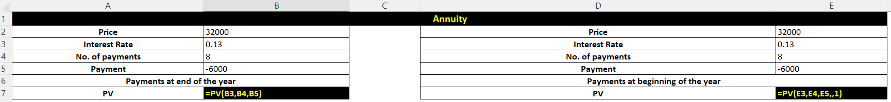
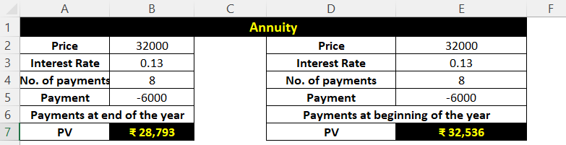
IMPLEMENTATION

Slide 9
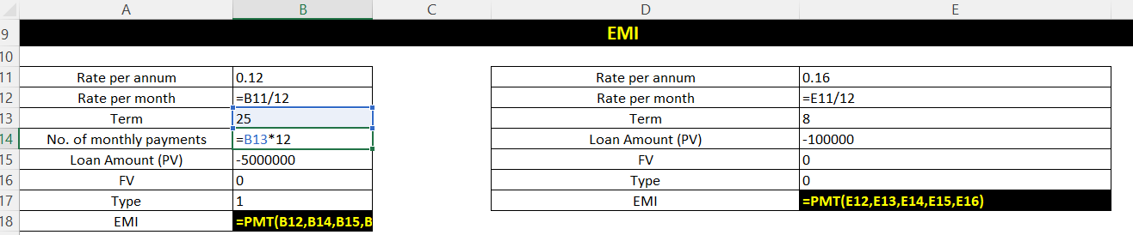
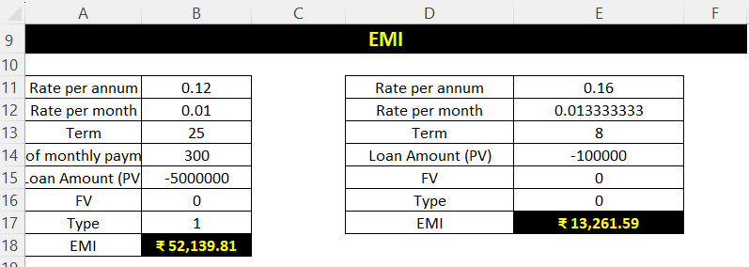

Slide 10
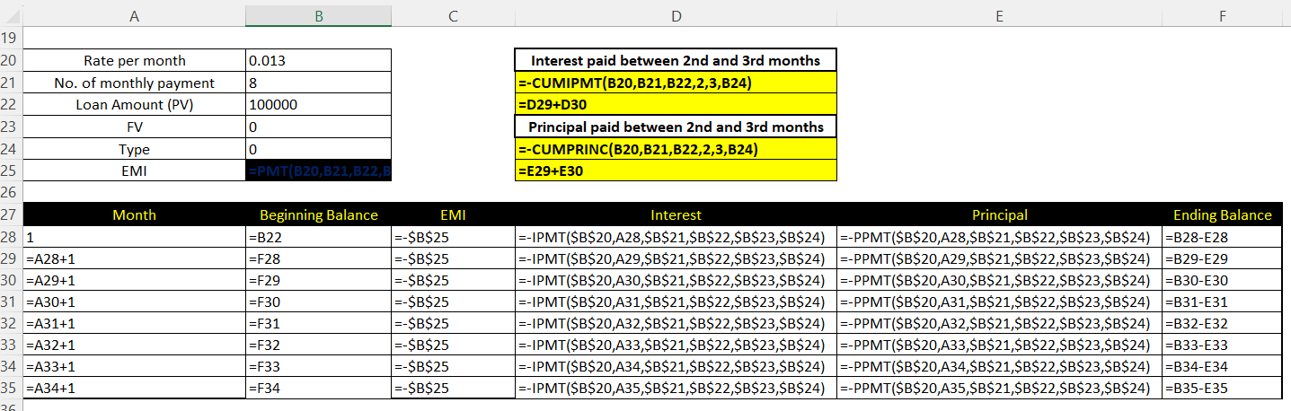
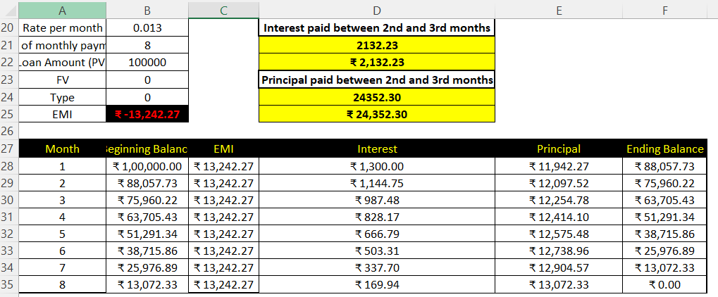

Slide 11
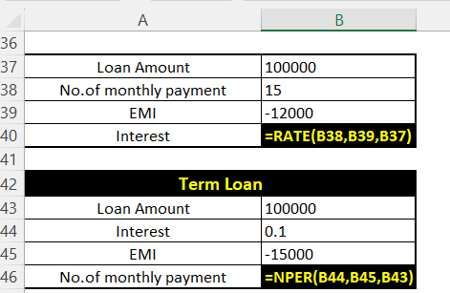
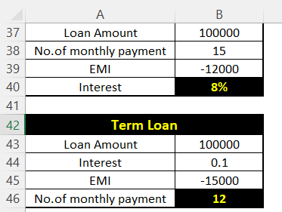

Slide 12
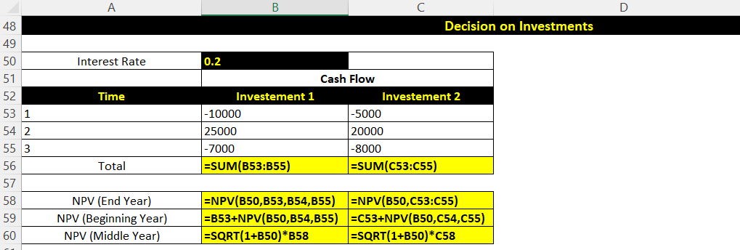
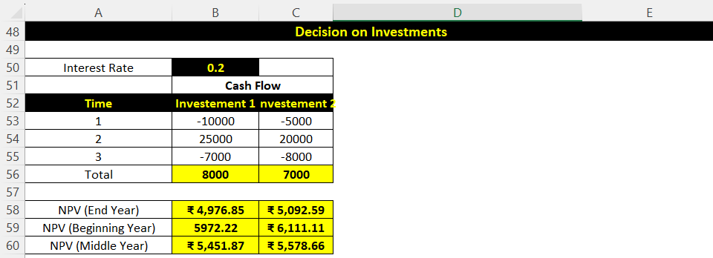

Slide 13
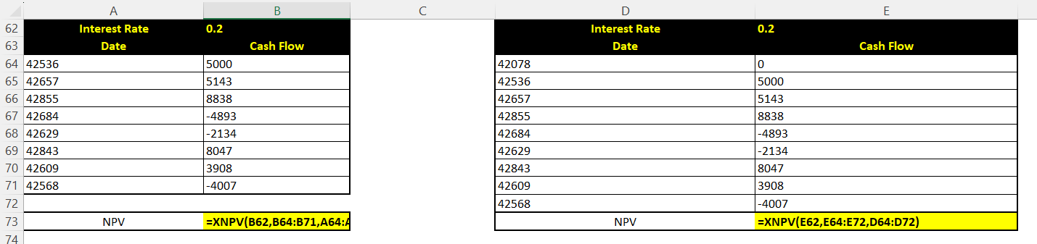
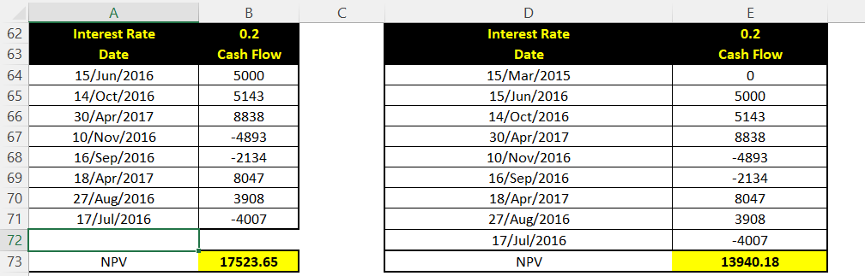

Slide 14
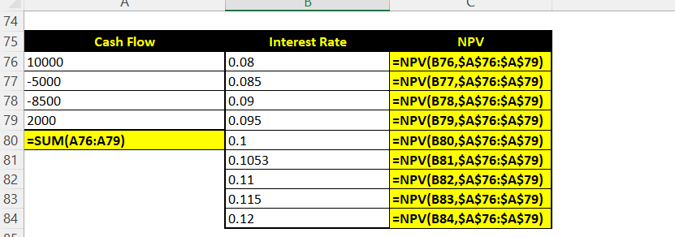
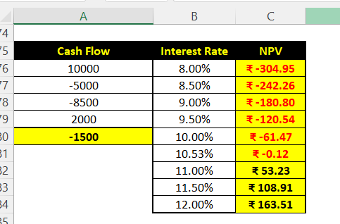

Slide 15
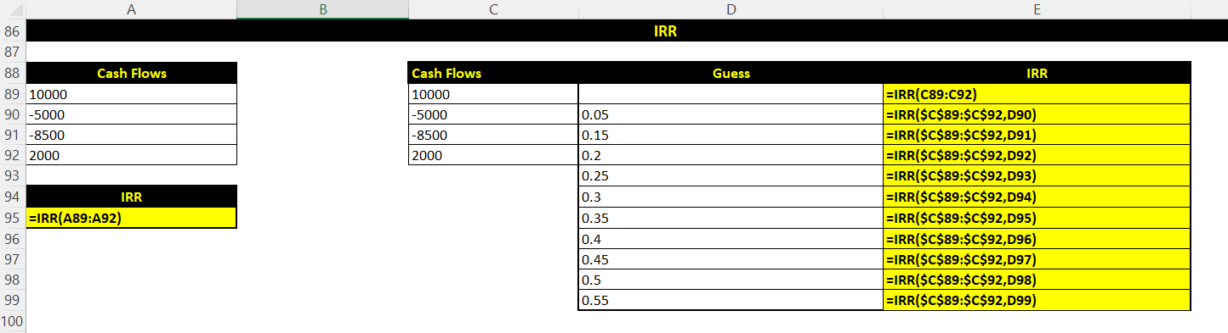
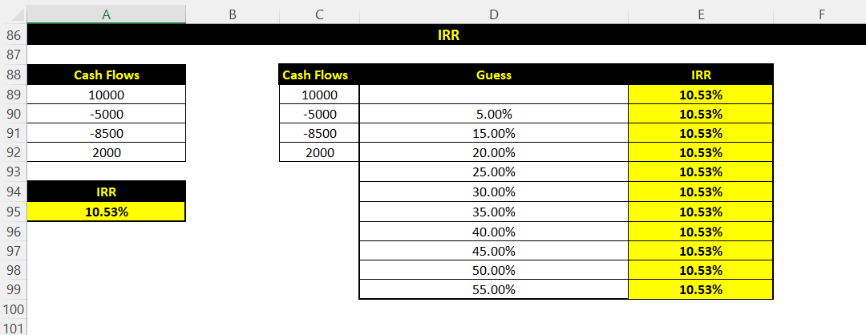

Slide 16
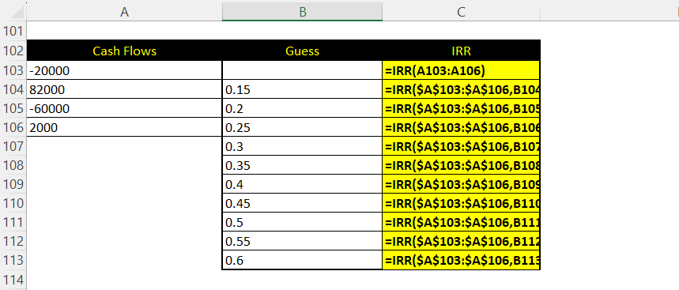
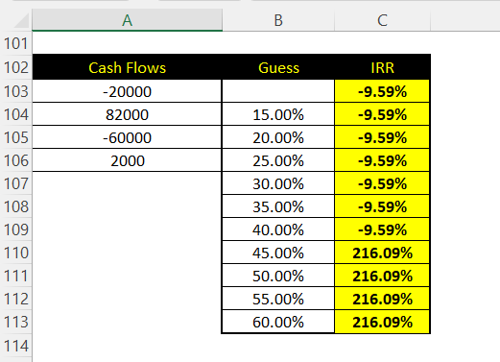

Slide 17
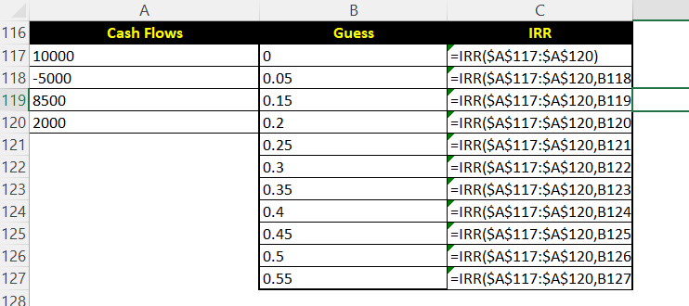

Slide 18
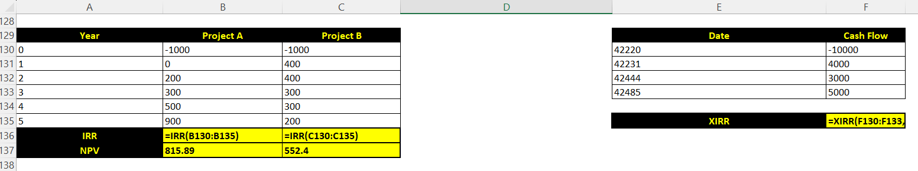
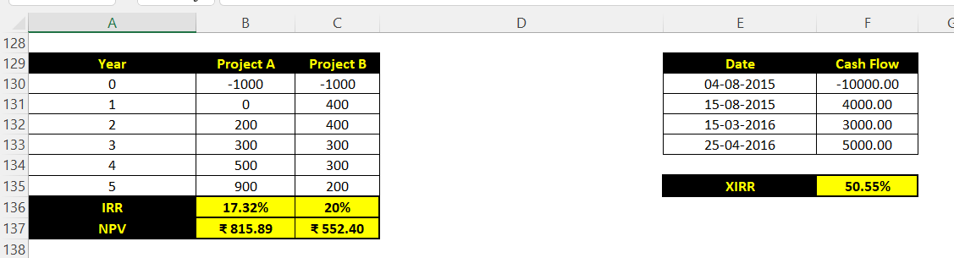

Slide 19
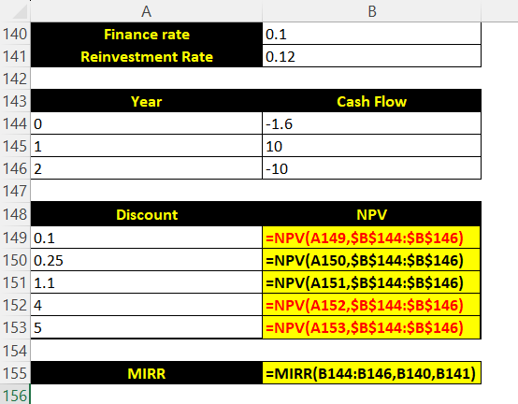
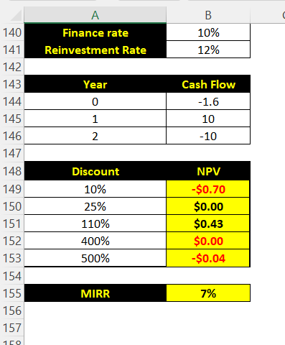

Slide 20
Key Findings
Annuity: Understood as regular, fixed payments over a period.
Present Value (PV): Lower PV for end-of-year payments; helps compare upfront vs. installment payments.
Net Present Value (NPV & XNPV): Useful to evaluate investments with regular and irregular cash flows.
EMI Calculation: Helps determine fixed monthly payments for a loan using PMT function.
Interest vs. Principal: EMI breakdown changes over time—interest decreases, principal increases.
Interest Rate (RATE): Can be derived based on loan terms and EMI capacity.
Loan Term (NPER): Calculates how long it will take to repay a loan.
IRR & XIRR: Evaluate investment profitability for regular and irregular cash flows.
MIRR: Considers both financing and reinvestment rates—more realistic than IRR.
Excel Functions Mastery: Enhanced understanding of real-world financial problem-solving using Excel.

Slide 21
Insights
Annuity: Understood the concept of constant cash payments over time.
Present Value (PV): Learned to calculate the current worth of future payments.
Net Present Value (NPV) and XNPV: Compared different investments based on future cash flows.
EMI: Determined the monthly installment for a loan and its components.
Interest Rate and Loan Term: Calculated the effective interest rate and the duration required to repay a loan.
Internal Rate of Return (IRR) and Modified IRR (MIRR): Assessed the profitability of investments considering different cash flow timings and rates.

Slide 22
CONCLUSIONS
This financial analysis project provided a practical understanding of core financial concepts like EMI, NPV, IRR, and loan amortization using Excel. By applying real-world scenarios, it improved decision-making skills related to investments, loans, and cash flow evaluation. It also strengthened Excel function expertise, making financial problem-solving more accurate and efficient.

